Slide 1
Chapter 6: Functions of Combinational Logic

Slide 2
Chapter Objectives
After studying this chapter, students should be able to:
Distinguish between half-adders and full-adders, and use full-adders to build multi-bit parallel binary adders.
Explain the operation of ripple carry and look-ahead carry adders.
Use magnitude comparators to determine the relationship between binary numbers, including using cascaded comparators for multi-bit comparisons.
Design and implement basic binary decoders and BCD-to-7-segment decoders.
Use encoders, such as priority encoders, and perform binary-to-Gray code and Gray code-to-binary conversions.
Apply parity checkers and multiplexers in digital systems and use them as function generators.

Slide 3
Chapter Outline
6.1 Half and Full Adders 6.2 Parallel Binary Adders 6.3 Ripple Carry and Look-Ahead Carry Adders 6.4 Comparators 6.5 Decoders 6.6 Encoders 6.7 Code Converters 6.8 Multiplexers (Data Selectors) 6.9 Demultiplexers 6.10 Parity Generators/Checker
Multiple-choice test and Problems

Slide 4
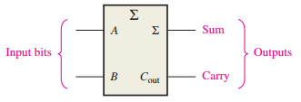
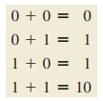
6.1 Half and Full Adders
The Half-Adder
Half-adder adds two bits and produces a sum and an output carry.
The half-adder accepts two binary digits on its inputs and produces two binary digits on its outputs—a sum bit and a carry bit.

Slide 5

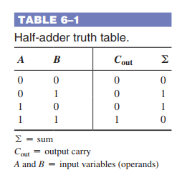

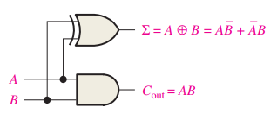
6.1 Half and Full Adders
Half-Adder Logic

Slide 6
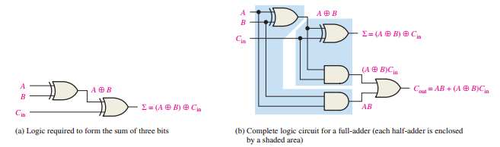
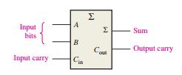

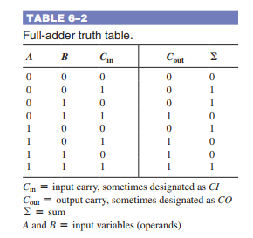
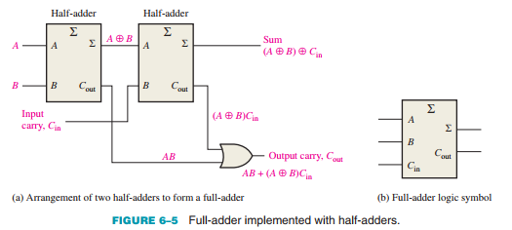
6.1 Half and Full Adders
The Full-Adder: A full-adder has an input carry while the half-adder does not.

Slide 7
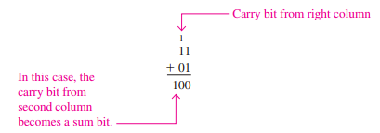
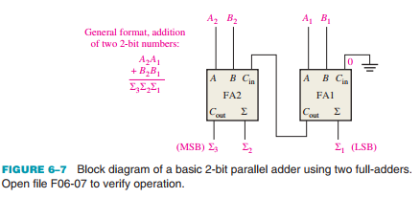
6.2 Parallel Binary Adders
Two or more full-adders are connected to form parallel binary adders. In this section, you will learn the basic operation of this type of adder and its associated input and output functions.

Slide 8
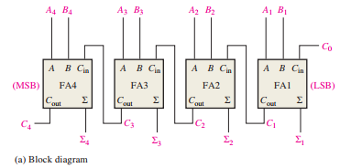
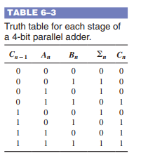
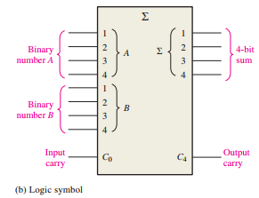
6.2 Parallel Binary Adders
Four-Bit Parallel Adders
Truth Table for a 4-Bit Parallel Adder

Slide 9
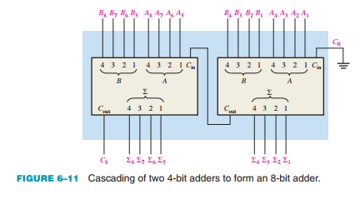
6.2 Parallel Binary Adders
Adder Expansion Adders can be expanded to handle more bits by cascading.

Slide 10
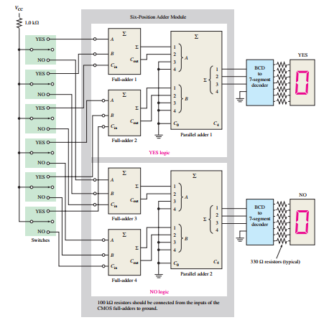
6.2 Parallel Binary Adders
An Application
An example of full-adder and parallel adder application is a simple voting system that can be used to simultaneously provide the number of “yes” votes and the number of “no” votes

Slide 11
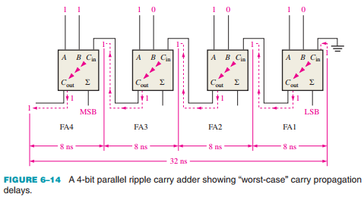
6.3 Ripple Carry and Look-Ahead Carry Adders
The Ripple Carry Adder A ripple carry adder is one in which the carry output of each full-adder is connected to the carry input of the next higher-order stage (a stage is one full-adder).

Slide 12

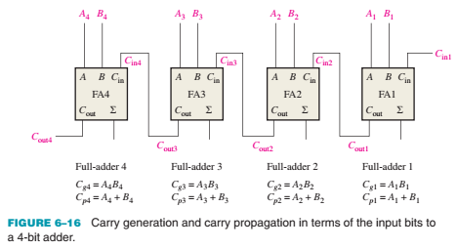
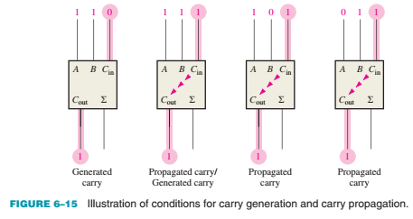
6.3 Ripple Carry and Look-Ahead Carry Adders
The Look-Ahead Carry Adder The speed with which an addition can be performed is limited by the time required for the carries to propagate, or ripple, through all the stages of a parallel adder.

Slide 13
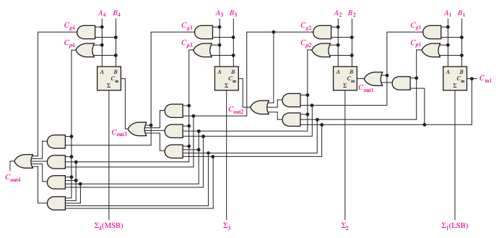
6.3 Ripple Carry and Look-Ahead Carry Adders
The Look-Ahead Carry Adder

Slide 14
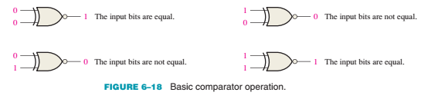
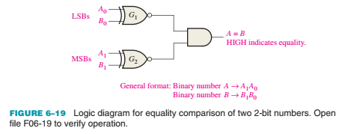
6.4 Comparators
Equality

Slide 15
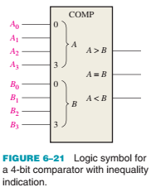
6.4 Comparators
Inequality To determine an inequality of binary numbers A and B, you first examine the highest order bit in each number. The following conditions are possible: 1. If A3 = 1 and B3 = 0, number A is greater than number B. 2. If A3 = 0 and B3 = 1, number A is less than number B. 3. If A3 = B3, then you must examine the next lower bit position for an inequality.

Slide 16
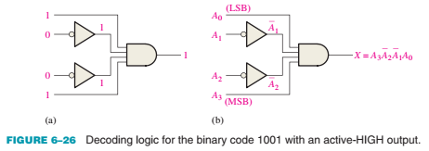
6.5 Decoders
A decoder is a digital circuit that detects the presence of a specified combination of bits (code) on its inputs and indicates the presence of that code by a specified output level.
The Basic Binary Decoder

Slide 17
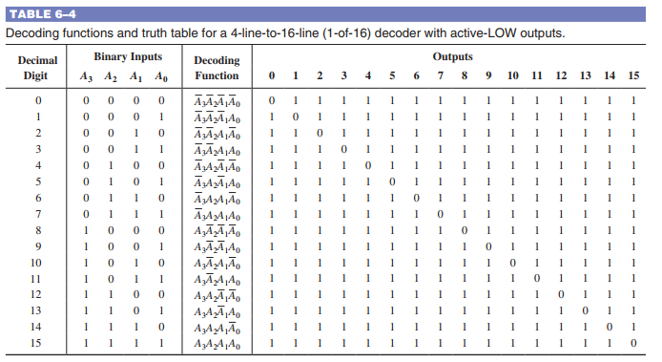
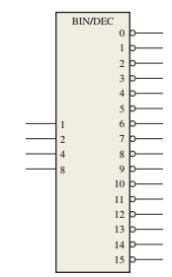
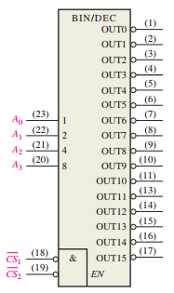
6.5 Decoders
The 4-Bit Decoder In order to decode all possible combinations of four bits, sixteen decoding gates are required (24 = 16).

Slide 18
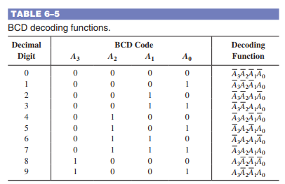
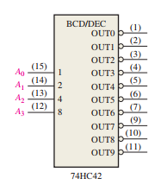
6.5 Decoders
The BCD-to-Decimal Decoder The BCD-to-decimal decoder converts each BCD code (8421 code) into one of ten possible decimal digit indications. It is frequently referred as a 4-line-to-10-line decoder or a 1-of-10 decoder.

Slide 19
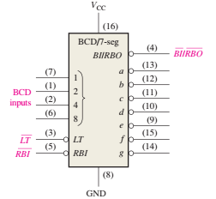
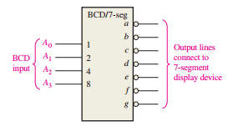
6.5 Decoders
The BCD-to-7-Segment Decoder The BCD-to-7-segment decoder accepts the BCD code on its inputs and provides outputs to drive 7-segment display devices to produce a decimal readout.

Slide 20
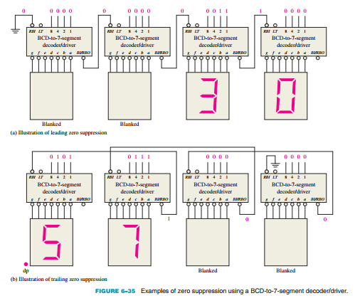
6.5 Decoders
Zero Suppression for a 4-Digit Display Zero suppression results in leading or trailing zeros in a number not showing on a display.

Slide 21
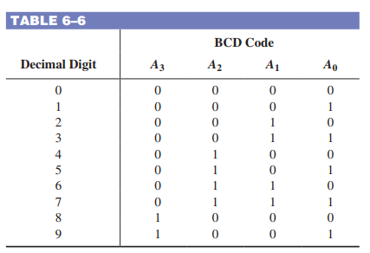
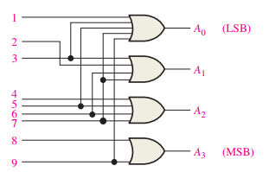
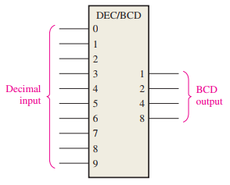



6.6 Encoder
An encoder is a combinational logic circuit that essentially performs a “reverse” decoder function. An encoder accepts an active level on one of its inputs representing a digit, such as a decimal or octal digit, and converts it to a coded output, such as BCD or binary. Encoders can also be devised to encode various symbols and alphabetic characters. The Decimal-to-BCD Encoder

Slide 22
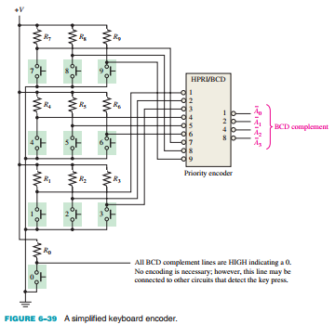
6.6 Encoder
An Application The ten decimal digits on a numeric keypad must be encoded for processing by the logic circuitry. In this example, when one of the keys is pressed, the decimal digit is encoded to the corresponding BCD code.

Slide 23


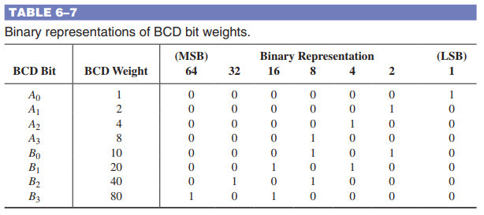
6.7 Code Converters
BCD-to-Binary Conversion The binary numbers representing the weights of the BCD bits are summed to produce the total binary number.

Slide 24
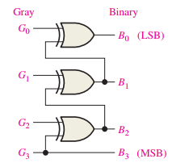
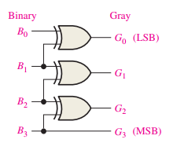


6.7 Code Converters
Binary-to-Gray and Gray-to-Binary Conversion

Slide 25
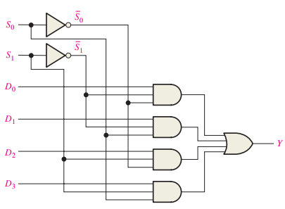
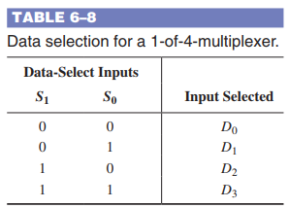
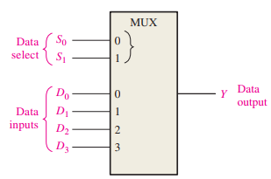

6.8 Multiplexers (Data Selectors)
A multiplexer (MUX) is a device that allows digital information from several sources to be routed onto a single line for transmission over that line to a common destination. The basic multiplexer has several data input lines and a single output line.

Slide 26
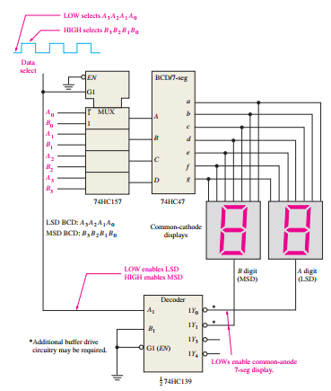
6.8 Multiplexers (Data Selectors)
Applications A 7-Segment Display Multiplexer
The basic operation is as follows. Two BCD digits (A3A2A1A0 and B3B2B1B0) are applied to the multiplexer inputs.

Slide 27
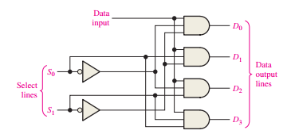

6.9 Demultiplexers
A demultiplexer (DEMUX) basically reverses the multiplexing function. It takes digital information from one line and distributes it to a given number of output lines. For this reason, the demultiplexer is also known as a data distributor. In a demultiplexer, data are switched from one line to several lines.

Slide 28
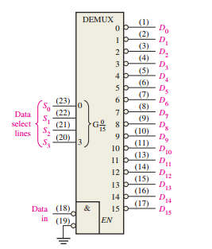
6.9 Demultiplexers
4-Line-to-16-Line Decoder as a Demultiplexer In demultiplexer applications, the input lines are used as the data-select lines.

Slide 29
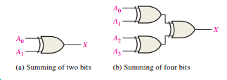
6.10 Parity Generators/Checkers
Basic Parity Logic A parity bit indicates if the number of 1s in a code is even or odd for error detection. The sum (disregarding carries) of an even number of 1s is always 0, and the sum of an odd number of 1s is always 1.

Slide 30
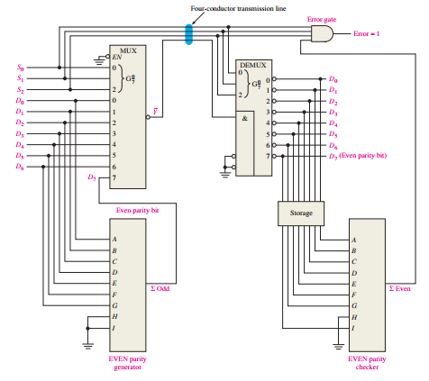
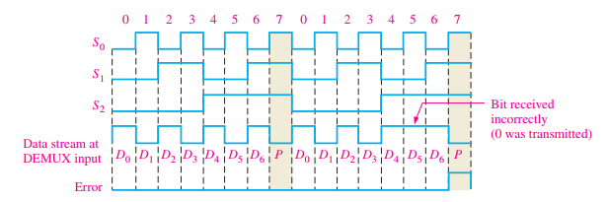
6.10 Parity Generators/Checkers
A Data Transmission System with Error Detection
In this application, digital data from seven sources are multiplexed onto a single line for transmission to a distant point. The seven data bits (D0 through D6) are applied to the multiplexer data inputs and, at the same time, to the even parity generator inputs.

Slide 31
SUMMARY
Chapter 6: Functions of Combinational Logic
The operations of half-adders and full-adders are demonstrated through truth tables, showing how they process input bits and produce sums along with carry outputs.
Combinational logic functions include comparators, decoders, encoders, code converters, multiplexers, demultiplexers, and parity generators/checkers.
Software versions of standard logic functions from the 74XX series are available for use in programmable logic design.

Slide 32
MULTIPLE-CHOICE TEST AND PROBLEMS
Complete the true/false questions, multiple-choice questions, and end-of-chapter exercises in the primary textbook.

